Slide 1
IoT As Easy as PI
By Darren Mills
Notes:
Thank you to everyone who has joined us here today to talk about how to make IoT as easy as Pi. We’ll be walking through a basic example of how to turn a Raspberry Pi into a Weather Station and integrate it into the AWS IoT ecosystem.

Slide 2


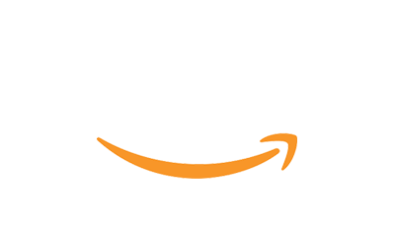



About CleanSlate
OUR SPEAKER
WHO WE ARE
Founded in 2000, we are a privately held company, headquartered in Carmel, Indiana. Voted “Best Places to Work in Indiana” from 2016 through 2018
CleanSlate dedicated practices:
Cloud, Enterprise Integration, Salesforce
Our team has a combined total of 49 years of cloud experience. Our heads are in the clouds…
DARREN MILLS
Director of Technology
AWS Certified • Salesforce Certified
MuleSoft Certified • Java Certified
New Relic Certified
Fun Fact – Licensed pilot and I like to watch scary movies
Join us on Slack:
#sponsor-cleanslate
OUR PARTNERS
Notes:
But first, a quick commercial on who CleanSlate is and a little background on myself.
CleanSlate is a local consulting company that is an AWS Advanced Partner specializing in Application Modernization using Cloud-based technologies. We also have partnerships with complimentary companies like Docker, Microsoft, Salesforce, etc. to help companies in multiple areas.
My name is Darren Mills and I am the Director of Technology for CleanSlate where I help align our technical strategy with the demands we see in our market. I have been in the industry for over 20 years where I started out as a Java Developer, which led towards Enterprise Integration and recently I’ve spent about the last 5 years building those solutions in the AWS platform.

Slide 3
SESSION AGENDA
Internet of Things Overview
General overview of IoT to understand how it fits in today’s market and the common challenges of a successful implementation.
AWS IoT Services Overview
Learn about the AWS IoT Services that can enable your business to quickly and securely implement IoT enabled products.
AWS IoT Raspberry Pi Weather Station
Learn about the components of a Raspberry Pi that comprise of the Weather Station and how they fit within the AWS IoT architecture to collect its statistics.
AWS IoT Weather Station Demo
Let’s walk through the configuration steps required to connect an IoT device to the AWS IoT platform and configure secure communication between the gateway device and your AWS endpoint.
Notes:
For today’s talk, I will start with an overview of IoT for those of you that may be new to the technology and talk a little about where it is at in the market and some of today’s challenges.
Next, I’ll give an overview of the AWS IoT Platform and highlight some of the technologies that we’ll be focusing on in this segment. Some of the other conference talks will focus different AWS IoT offerings, so by the end of the conference, you should have a good handle on the platform capabilities.
Finally, we’ll talk about and demo how to implement a Weather Station using a Raspberry Pi device and how it integrates with the AWS IoT Platform.

Slide 4
Internet of Things (IOT) Overview
Internet of Things (IoT) is a system of devices connected to the Internet with the ability to collect and exchange data from users or environment with no human intervention.
The device or “thing” in IoT could be any type of device embedded with specialized software to interact with its electronics or sensors.
Home Automation / Amazon Alexa / Google Nest / Smart Lights
Security System / Doorbells
Health Monitors
Automobile Diagnostics
Government / Traffic Lights
Notes:
Internet of Things, commonly known as IoT has been around for almost 30 years, but within the last several years, we have seen an explosion in the market. By definition, IoT is a system of devices connected to the Internet with the ability to collect data with no human intervention. That is a rather broad definition, but that is exactly why this market has exploded.
With the advances in technology to makes things smaller and cheaper, companies become very creative in their efforts to take advantage of this space. Things have become so cheap they are flooding the consumer space and I imagine many of us have at least 1 IoT device in our homes, if not more. They range from:
Home Automation Systems like Alexa or Google Nest
Security Systems and Video Doorbells like Ring
Health Monitors, like a FitBit or Apple Watch
But they are also used to create other “Smart” devices like diagnosing your automobile or helping with the flow of traffic by optimizing Traffic Lights.

Slide 5
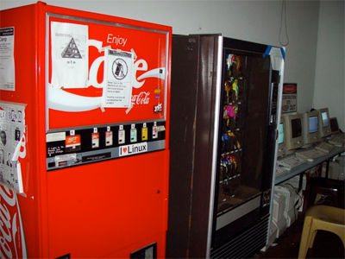
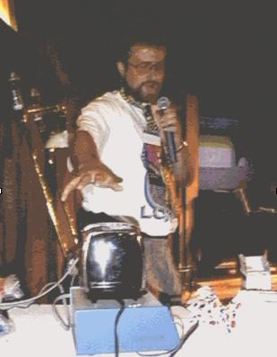
IOT Fun Facts
The first IoT device was a Coke vending machine at Carnegie Mellon University in 1982. It was connected to the internet and reported the inventory and temperature of the drinks. It was later followed up in 1989 with an Internet managed Toaster for a conference, by John Romkey.
The term “Internet of Things” was coined in 1999 by Kevin Ashton from MIT, by accident when used as the title of a presentation. He later thought “Internet for Things” was a better fit, but the name had stuck.
Currently, there are more IoT devices connected to the Internet than the World population
Notes:
If we take a step back and look at some of the original reasons why IoT was created, it may become amusing about just how lazy we can be. Since today, we can do so many things without leaving our recliners.
The first IoT device was the brainchild of a professor at Carnegie Mellon University where his office location was a very long walk to the Coke Machine. He would often venture to get a drink and find either the machine was empty or just recently stocked with warm beverages. So, he decided to create his own circuit board that would interact with the Coke Machine to measure the inventory and check the temperature. This ensured his long walk would be met with a nice cold Coca-Cola.
This was later followed by a publicity stunt that created the “Internet Toaster”. You could start the toaster via the internet, but you still had to manually load the bread…
The IoT acronym was coined in 1999 as the title of a presentation about how RFID chips would change the world… as an afterthought, Internet for Things may have been a better fit.
One statistic that I find amazing is that there are more IoT devices connected to the internet than the world population… thus our need for IPv6 eventually!

Slide 6
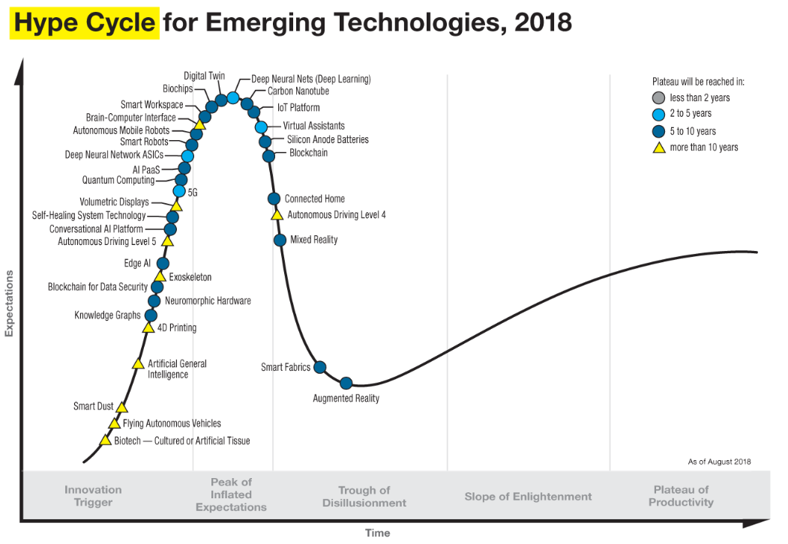
IOT In the market
“Things” Deployed
2018 – 7 Billion
2019 – 26 Billion
2020 – 31 Billion
Top Industries (2020)
Utilities
Security
Healthcare
Automotive
Consumer (Home)
Notes:
Although the market seems have adopted IoT technologies, I like to use the Gartner Hype Cycle as a resource to understand where we are at within the technology adoption. This Hype Cycle from 2018 helps gauge the maturity and adoption of emerging technologies and is divided up into 5 different phases.
The first phase, Technology Trigger, is where the incubator and Proof of Concepts of new technologies are formed.
The second phase, The Peak of Inflated Expectations, is when companies believe this new technology is the Silver bullet to all their problems and start their own implementation.
The third phase, Trough of Disillusionment, is when projects fail because of either poor implementations or lack of business value. Most of these initial projects will fail, but some will succeed and set the foundation for the market to.
For instance, I have 3 different “Smart” appliances that no longer have applications supporting their IoT functionality… they were developed during the second phase with lack of business value. I won’t shame the brand name either.
The next 2 phases, Slope of Enlightenment and Plateau of Productivity, are when the technology start to become mainstream and stable. Mostly because of widely adopted frameworks and standards that help companies from making repetitive mistakes.
This is where I feel like IoT is at today and platforms like what AWS has created helps to accelerate its adoption.

Slide 7
IoT Challenges
Implementation is difficult due to the complex nature of the different components in the ecosystem of IoT
Communication | Security | Presence Detection | Power Consumption | Bandwidth
Devices may be talking to a server to collect data, or the server may be talking to the devices, or maybe those devices are talking to one another. Data needs to get from point A to point B quickly and reliably. | Authorization: It’s essential to make sure that the IoT device and endpoint has proper authorization to send or receive the stream of data. Open Ports: Devices are vulnerable when listening to an open port out on the Internet. Encryption: Data should be encrypted between devices and endpoints. | It’s important to know when an IoT device goes offline and when that device comes back online. | IoT devices signaling and sending data between one another takes a toll on power and CPU consumption. With all this communication, you need minimal battery drain and low power consumption. | Bandwidth on a cellular network is expensive. Especially with hundreds of thousands of IoT devices on a network sending request/response signals to your endpoint.
Notes:
So, let’s talk a little bit about why the IoT arena is still a complicated space that offers challenges for companies to succeed.
Communication must be quick, and it must be reliable
Security is paramount, you must handle authorization, ensure open ports are not compromised and enforce encryption of all data exchanged.
Presence Detection is required to maintain the state of a device, whether is online or offline.
You must be able to support all these requirements but minimize the power consumption.
You have limited bandwidth, so you must ensure your services are not chatty.
One or two of these problems are not that hard to implement, but when you attempted to solve them all with little to no standards, it becomes a difficult challenge.

Slide 8
IoT Challenges - Data
“One of the myths about the Internet of Things is that companies have all the
data they need, but the real challenge is making sense of it.”
– Chris Murphy, Information Week
Volume | Security | Privacy | Analytics
Large amounts of data continually being gathered in real-time from thousands/millions of devices simultaneously IoT data expected to double every two years, which requires large flexible storage solutions | Ensure data is secure both in transit and at rest through encryption and key management Ensure the integrity of the data from devices to ensure the device has not been compromised | Removal of PII data to protect the identities of the consumers Lack of data classification standards to protect confidential data Legal ramifications of large data collection and data retention Public perception of eavesdropping and profiling | Data Analytics is the key to making enhanced business decisions and efficiency gains Difficult to consolidate data which is a mixture of structured and unstructured information across the enterprise Too much data to analyze thus requires some form of AI/ML to provide insight into future business decisions
Notes:
There is also another challenge that is often overlooked with IoT and that is what do you do with the massive amount of data that is being generated from all these devices. Many of the business drivers behind IoT was to capture data about “something”, but when you have thousands or millions of devices deployed and collecting data, it can be difficult to manage.
Terabytes of data are being generated which lead to issues around managing storage capacity
Security is obviously a concern when you have that type of volume, but privacy issues are also something that needs to be dealt with. How do you ensure consumer information is removed to prevent the perception of profiling and eavesdropping on personal behaviors?
Most importantly, what are you going to learn from all this data being collected. To solve that problem, we may need to lean upon AI/ML to help analyze what it is telling us so we can make better business decisions.

Slide 9










Amazon IoT Services
DEVICE SOFTWARE
FreeRTOS
AWS IoT Greengrass
CONTROL SERVICES
AWS IoT 1-Click Service
AWS IoT Core
AWS Device Management
AWS Device Defender
ANALYTICS SERVICES
AWS IoT Analytics
AWS IoT Events
AWS IoT SiteWise
AWS IoT Things Graph
Notes:
Let’s transition for a second to learn about what services AWS offers within the IoT Platform and how they might help mitigate many of the problems I just outlined.
Their offerings can be categorized into 3 different domains.
Device Software – products that help make creating an IoT Devices easier
Control Services – products that make interacting with our Devices easier
Analytic Services – products that help us learn from the Data we are collecting.
During today’s presentation we will focus on the Control Services, but I know some of the other products are being talked about within the conference.

Slide 10
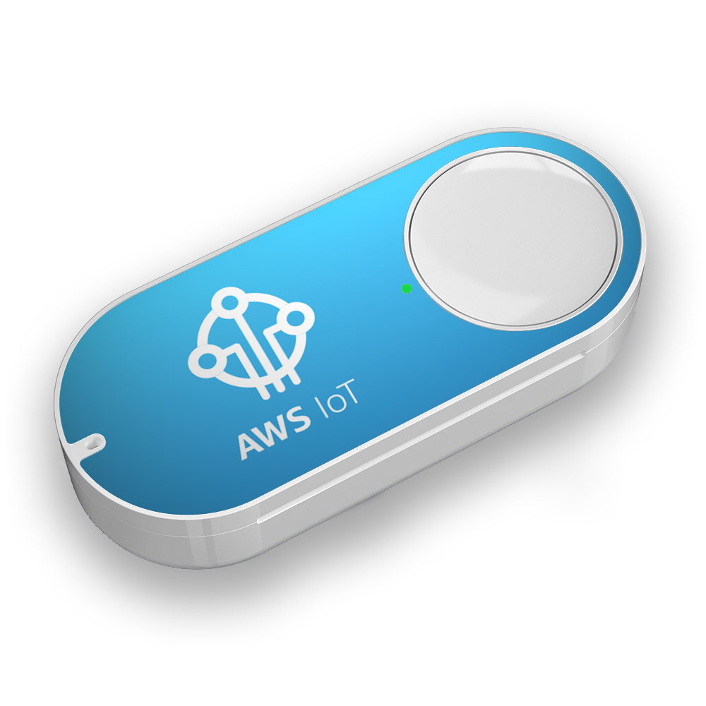
AWS IOT 1-Click Service
AWS IoT 1-Click is a service that enables simple devices to trigger AWS Lambda functions that can execute an action
Easily trigger Lambda functions from supported devices
Secure connectivity right out of the box
Easy to manage supported devices
Enterprise Dash Button
Implemented via the AWS IoT 1-Click Service
3 Different Button Actions
Single Click
Double Click
Long Press
Notes:
First off, let me pivot to one of the technologies that is considered the entry point into the IoT space, the AWS IoT 1-Click Service. It is catered to the beginner IoT developers and provides a very easy to use mobile interface to register and develop pre-packaged Lambda functions to send email, send SNS notifications, and many other things. It has the ability to execute 3 different functions based upon the button action, single-click, double-click or a long click… each mapping to a different Lambda function.
Although the enterprise version of the Dash button has been discontinued, you may still purchase these types of devices from AT&T or find one of the original buttons on eBay.

Slide 11
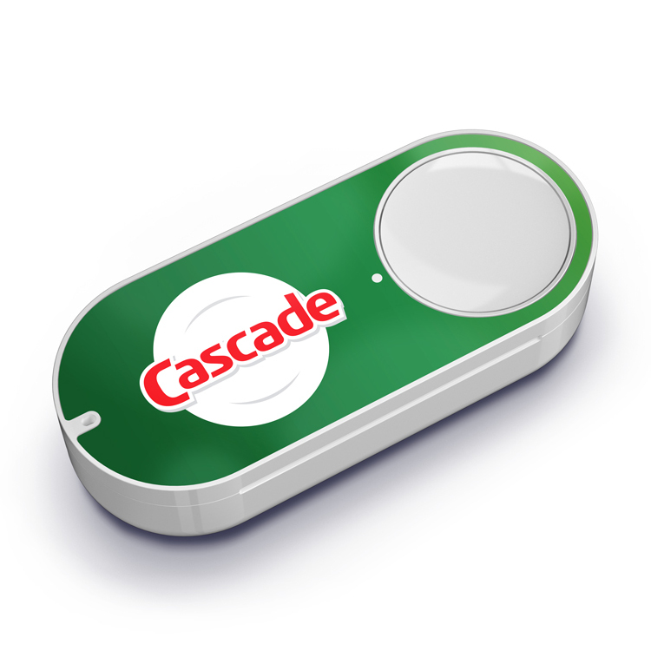
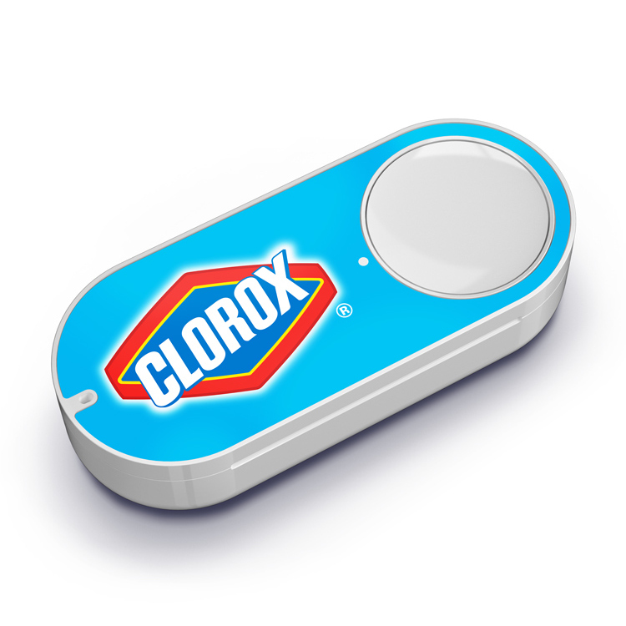

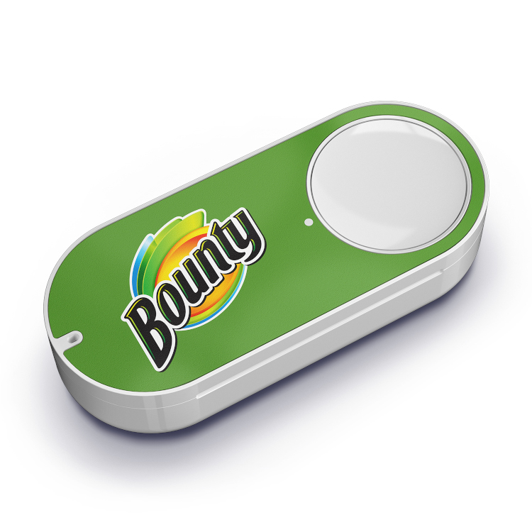
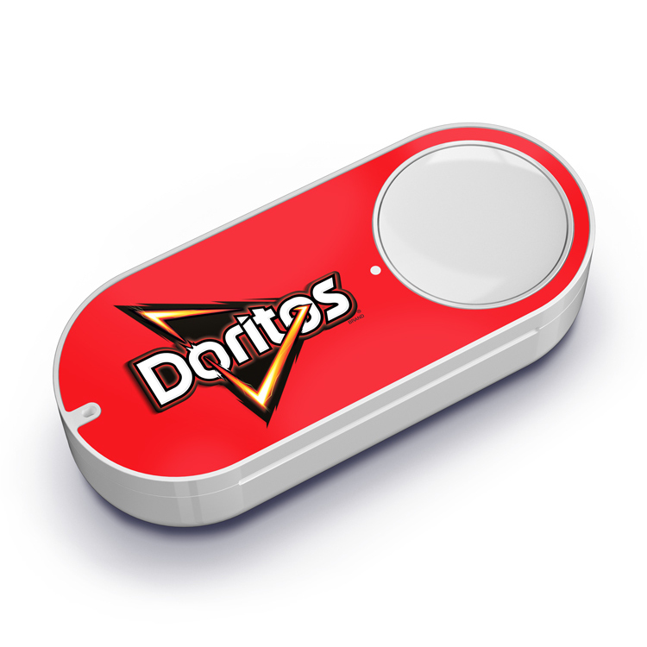
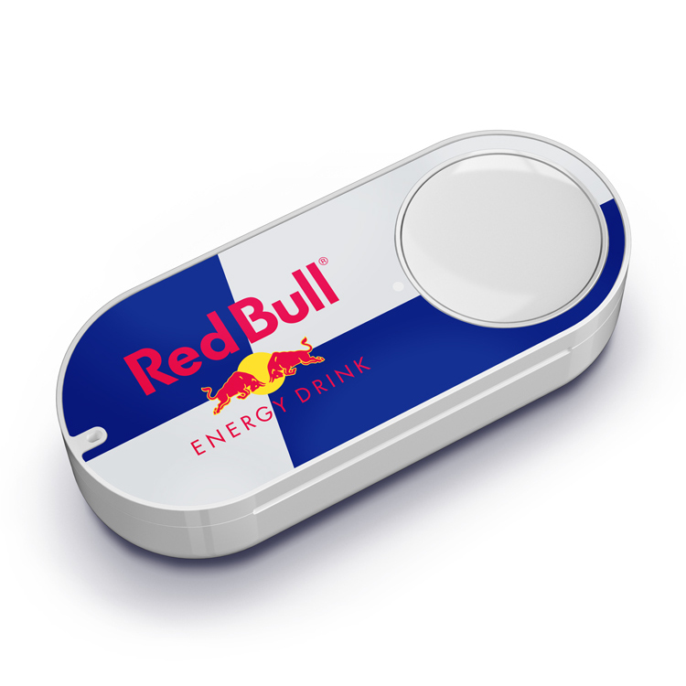
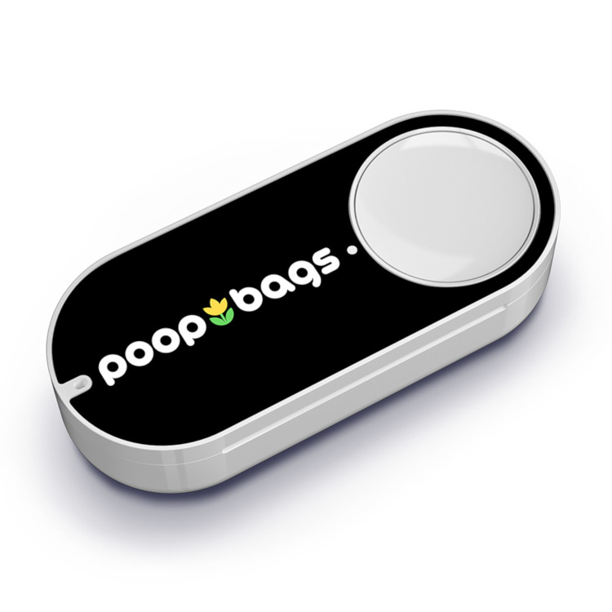
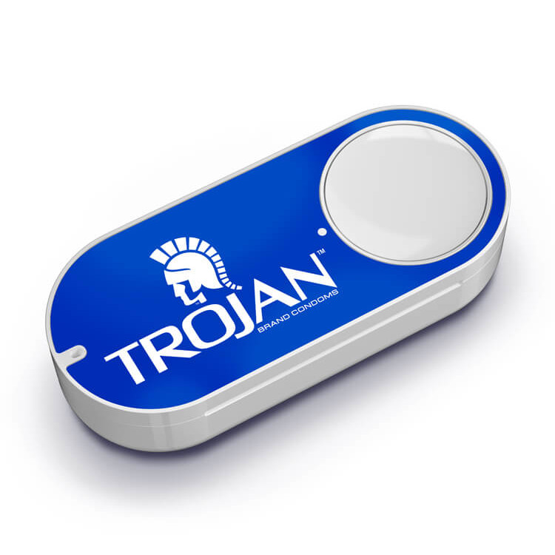
AWS Dash Button HISTORY
Introduced on March 31, 2015 – originally believed to be an April Fools joke
Over 250+ Dash Buttons were introduced
Amazon’s first IoT Device targeted to quickly replenish household items
Helped Amazon learn buyer characteristics to augment their AmazonFresh grocery service
Discontinued on August 31, 2019
Amazon Alexa replaced functionality
Consumer Rights violations because price was not known by end user upon ordering
Notes:
This technology was the basis for the Amazon Dash button that let you replenish your home goods from just a click of a button. This was Amazon’s first true IoT device and they announced its availability on March 31, 2015… the idea was so absurd, many thought it was an April Fools joke. But, nope… it was real life and over 250 different buttons were developed.
As I mentioned before, data is the business driver for many of the IoT devices we see today, and the Dash button was no different. Amazon was able to learn about many of their consumer’s buying characteristics to help augment their AmazonFresh Grocery service.
However, the product offering was discontinued last year, mostly because the functionality was replaced with Alexa, but also because they were facing consumer right violations in Europe due to the price not being disclosed upon purchase.
I listed some of my favorite Dash buttons on the right, but some of them just blow my mind. I had to look-up what poop-bags was for and was disappointed to learn it was used while taking your dog for a walk. That brings me to the #1 ranked fan-favorite, the Trojan Dash Button, I’ll let you do your own research for that one because it certainly sounds romantic.

Slide 12
AWS IOT DEVICE SOFTWARE
AWS IoT Device Software provides the essential building
blocks to create cloud managed IoT devices.
FreeRTOS
Open source, real-time operating system for microcontrollers that makes small, low-power edge devices easy to program, deploy, secure, connect, and manage
IoT Greengrass
Extends AWS to edge devices so they can act locally on the data they generate, while still using the cloud for management, analytics, and durable storage.
Amazon Common Software (ACS) – released in Feb. 2020, still in preview
Optimized software for integrating Amazon Device SDKs on your devices
Frustration-Free-Setup (FFS) – making setup easier for the customer
Pre-validated and memory optimized components for common functions such as connectivity
Notes:
So, let’s jump back and talk about some of the core components to the AWS IoT Framework.
AWS offers device software to help you build your IoT devices. FreeRTOS (free-r-toss) is an operating system specialized for microcontrollers that require low power.
Greengrass helps bring AWS capabilities to the edge to help mitigate latency and connectivity issues. It can also help with privacy concerns to anonymize data before it is sent to the cloud, which may be important in the medical or regulatory fields.
Just recently released is Amazon Common Software (ACS) which means to simplify the Amazon SDKs on your devices and optimize their functionality. Currently, there is a broad and complex offering of SDKs based upon your device and coding language, so this is a great step forward.

Slide 13
AWS IOT CORE Service
AWS IoT Core is a managed cloud service that lets connected devices easily
and securely interact with cloud applications and other devices.
Connect and Manage your Devices
Supports HTTPS, WebSockets and MQTT and custom protocols
Secure Device Connections and Data
Automated configuration and authentication of device
Encryption provided End-to-End
Process and Act upon Device Data
Allows simple ways to filter, transform and act upon device data
Support business rules that interact with AWS Services like Lambda, Kinesis, S3, DynamoDB, etc.
Read and Set Device State
Allows the device to appear online to your application, even if the device is temporarily offline
Scale to Billions of Devices
Framework is built to support billions of devices and trillions of messages
Notes:
AWS IoT Core, sometimes referred to as the Hub, is the foundation of the platform. It provides all the capabilities you need to connect and manage your IoT devices.
Out of the box:
You are provided with secure communication between the cloud and your device
You can implement business rules to do things with the data you are collecting
You can also mitigate the impacts of having devices go online or offline by having messages get queued and republished, if necessary
It supports communication over HTTPS, WebSockets, MQTT and custom protocols. But the preference is given to MQTT because it has the lowest amount of overhead and can handle limited bandwidth.

Slide 14
AWS IOT DEVICE MANAGEMENT
AWS IoT Device Management makes it easy to securely register,
organize, monitor, and remotely manage IoT devices at scale.
Fast Device Registration
IoT Registry provides ability to securely manage a large fleet of devices quickly
Simple IoT Device Organization
Allows your devices to be organized into groups and manage policies at a group level
Locate Connected Devices Quickly
Provides search capabilities to find devices in your fleet based upon ID, state, attribute, etc. quickly
Easy Remote Device Management
Allows you remotely update the software running on your devices after they have been deployed in the field, ensuring your devices are always running on the latest software version
Notes:
AWS IoT Device Management is a helper service to the Core and provides the capabilities to register devices and manage them. As your fleet grows, you can divide them into groups and manage at the group level versus the device level. This provides you the ability to scale the fleet to a large number of devices. Additionally, it can help push out software patches to these devices when they are online, so users do not have to worry about any type of maintenance activities.

Slide 15
AWS IOT DEVICE DEFENDER
AWS IoT Device Defender is a fully managed service
that helps you secure your fleet of IoT devices.
Audit Device Configurations
Audits IoT configurations associated with your devices against a set of defined IoT security best practices
Monitor Device Behavior
Detects anomalies in device behavior that may indicate a compromised device
Allows you to define security rules:
Open Ports
Communication Routes (who can the device talk to and who can talk to the device)
Data Volume
Publish Security Alerts
Publishes security alerts to the when an audit fails or when behavior anomalies are detected
AWS IoT Console
Amazon CloudWatch
Amazon SNS
Notes:
AWS IoT Device Defender helps you secure your fleet of devices to help identify security risks. It provides a pre-configured audit based upon best practices to validate both your AWS IoT configuration and your device configuration. This can be scheduled and trigger alerts to be sent so that administrators are always up to speed.
It can also monitor device behavior and look for anomalies. If a device suddenly starts port scanning its network or sending data to a new IP address, then it could likely be a compromised device and generate a security alert.
This service is super easy to use and a good way to keep your name out of the news!

Slide 16
AWS IOT ANALYTIC SERVICES
AWS IoT Analytics is a fully-managed service that makes it easy to
operationalize analytics on massive volumes of IoT data.
Prepares your IoT Data for Analysis
Integrated with IoT Core to easily ingest device data
Provides capabilities to filter and transform data
Ability to integrate data from external sources with Lambda functions
Easily run Queries on IoT Data
Allows simple and ad hoc SQL queries to be executed on your data store
Data Storage Optimized for IoT
Data Store is optimized for time-series to deliver fast response times on IoT queries
Tools for Machine Learning
Apply machine learning to your IoT data with hosted Jupyter notebooks
Notes:
AWS IoT Analytic Services offer everything your business needs to slice and dice your IoT data to provide meaningful value to your company. The ingested data runs through a series of self-defined pipelines to massage your data via Lambda functions (data conversion, data enhancement, etc.). There is no need to worry about the underlying storage as it is optimized for time-series data and allows you to run ad hoc SQL queries against it. It also has the capabilities to apply machine learning and visualize your data with Jupyter notebooks.

Slide 17

IoT Challenges - SOLVED
Problem | Solution | Solved?
Communication | AWS IoT Core (HTTPS, WebSockets, MQTT)
Security | AWS IoT Core (X.509 client certificate) AWS IoT Device Defender Amazon Cognito
Presence Detection | AWS IoT Greengrass AWS IoT Core (Shadow Devices)
Power Consumption | AWS FreeRTOS
Bandwidth | AWS IoT Core (HTTPS, WebSockets, MQTT)
Data Volume | AWS S3 AWS RDS AWS DynamoDB
Data Security | AWS IoT Core (X.509 client certificate) AWS IoT Device Defender
Data Privacy | AWS IoT Device Defender Amazon Macie (PII Data Detection)
Data Analytics | AWS IoT Analytic Services
Notes:
Although we covered the highlights of the AWS IoT platform quickly, it is a single platform that can scale to meet your business needs. Each one of these products offer a ton of functionality, but when you combine them with the other AWS offerings, you get a very powerful toolset to tackle your challenges.
Let’s look at some of the challenges that I discussed earlier and see how the AWS platform may or may not solve them. Although this is my personal and somewhat biased opinion, I feel that AWS has an answer for each of the challenges.
Some of these services are not IoT specific, which is the beauty of the AWS Cloud… you get many other tools in your toolbelt. For instance, AWS Cognito can help you with your security requirements and integrate seamless into the IoT platform. Services like Amazon Macie can help alert you to any sensitive data being exposed in your data.
Overall, there may be better individual solutions here and there, but as a single offering, it covers the gamut.

Slide 18







AWS IOT WEATHER STATION
Notes:
Now that we have covered the AWS IoT ecosystem, let’s have some fun and put it to use creating a simple Weather Station that will calculate the temperature and humidity of its environment.

Slide 19
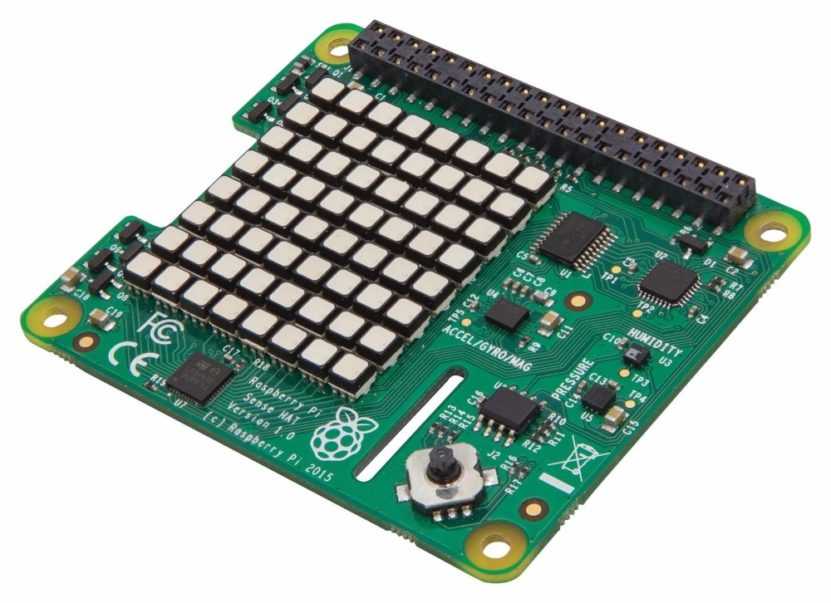
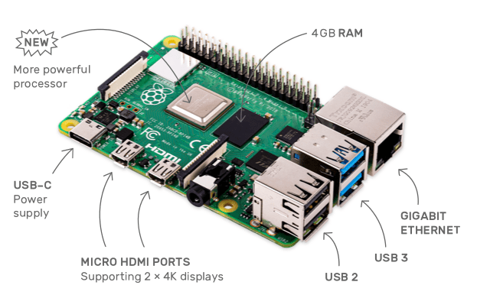
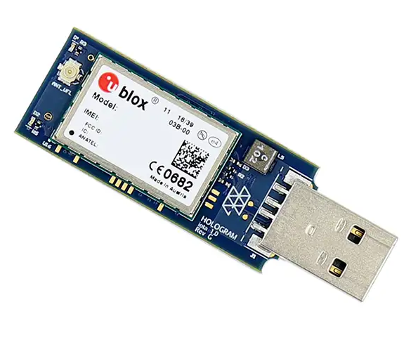
RASPBERRY PI WEATHER STATION
Raspberry Pi 4 Model B Serves as the IoT Gateway device which is registered with the AWS IoT Platform. 1.5 GHz 64-bit quad-core ARM processor 4GB RAM USB 2 / USB 3 Support Two 4k Micro HDMI Display Ports GB Ethernet USB-C Power Supply | Raspberry Pi Sense HAT The Sense HAT is an add-on board to provide different weather instrumentation. Launched to ISS in 12/2015. Hologram Nova Cellular Modem A cellular modem purpose-built for IoT development.
Sensors:
Temperature
Humidity
Barometric Pressure
Gyroscope
Accelerometer
Magnetometer
Models Support:
2G, 3G and LTE cellular coverage
External Antenna
Python SDK
Notes:
First, we must design our “Thing” that will be deployed. In this case being a true nerd on CleanSlate’s budget, I chose to use these components.
Raspberry Pi 4, which is a mini-computer w/4 cores and 4GB of RAM running Raspbian, which is a Linux based Operating System.
Raspberry Pi Sense HAT to provide the sensors related to the weather instrumentation. This device was designed as part of the Astro-Pi program which was launched to the International Space Station in 2015.
Finally, a Hologram Nova Cellular modem to provide communication when the device is outside of wireless range. Unfortunately, I snapped the antenna and the current delays with Amazon have prevented me from receiving the replacement part yet. Ironically, it will probably arrive at some point during my talk.

Slide 20
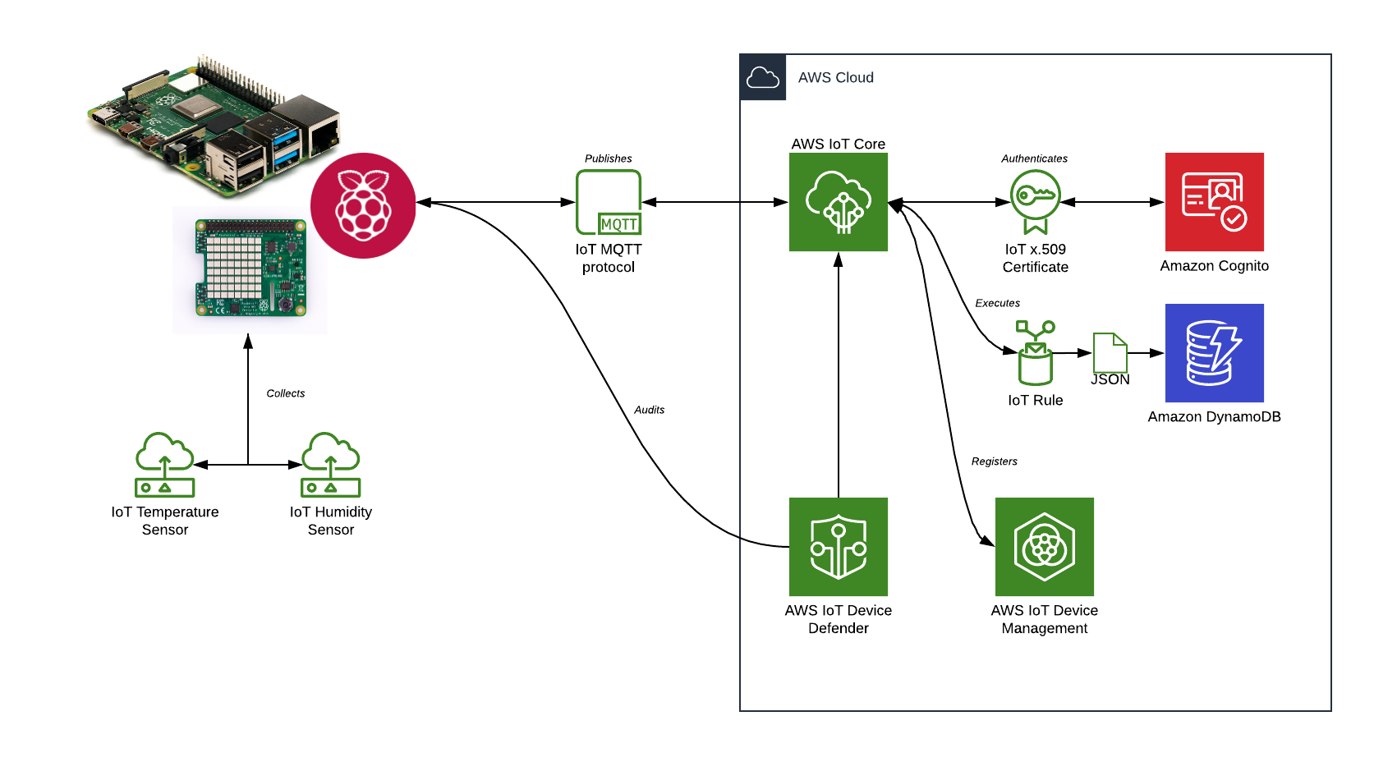
WEATHER STATION ARCHITECTURE
Notes:
Let’s take a few minutes and talk about the architecture that makes all of this happen.
First, let’s assume our device is already registered and secured with the platform using the Device Management Service, which we’ll cover in a few slides.
We have our Raspberry Pi deployed and its weather sensors are collecting data about its environment.
This data will be packaged as JSON in a MQTT message that is published to a topic defined in the Core service.
During this exchange, a connection will be established, and the “Thing” will be authenticated using its x.509 certificate with Amazon Cognito.
Once authenticated, the message will be placed on the topic so that business rules can be executed. In our case, we have a business rule defined that says we want to save the message payload into our Amazon DynamoDB.
At that point, our rules are done executing, the message is purged from the topic and we rinse and repeat… over and over again.
In addition, we also have Device Defender periodically running an audit test against our Core service and the “Thing” to identify any security vulnerabilities.

Slide 21
IOT GETTING STARTED
Register Your Thing
Register your device with the AWS IoT Core Framework to allow it to be managed by the platform.
Secure Your Thing
Secure your device by generating the required certificates and policies to allow secure communication between your gateway and the platform. In addition, we will register our device with AWS Cognito for Unauthenticated Identities.
Develop and Deploy Your Thing
Develop the require code to support your functionality with the AWS SDK for IoT.
Test Your Thing
Utilize the built-in testing tools provided with the AWS IoT platform to ensure two-way communication with your device.
Notes:
Now, let’s get ready to build this Weather Station. We’ll cover how this is done in the following steps:
How to register your Thing
How to secure your Thing
How to develop and deploy your Thing
How to test your Thing

Slide 22
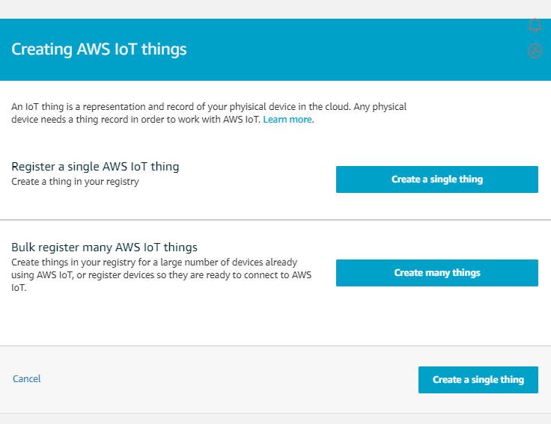
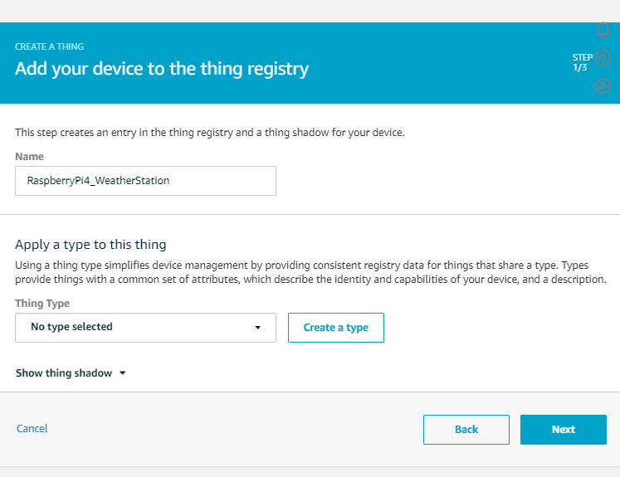
Register your Thing
Pre-Steps
Logon to the AWS Console
1
Search for the IoT Core Service
Select “Manage” and then “Register a Thing”
Click the “Create a single thing” button
2
Name your Thing
Name: RaspberryPi4_WeatherStation
Notes:
First up, How to Register your Thing. The IoT Core Service provides a very easy to walk through wizard to get your Thing registered quickly…

Slide 23
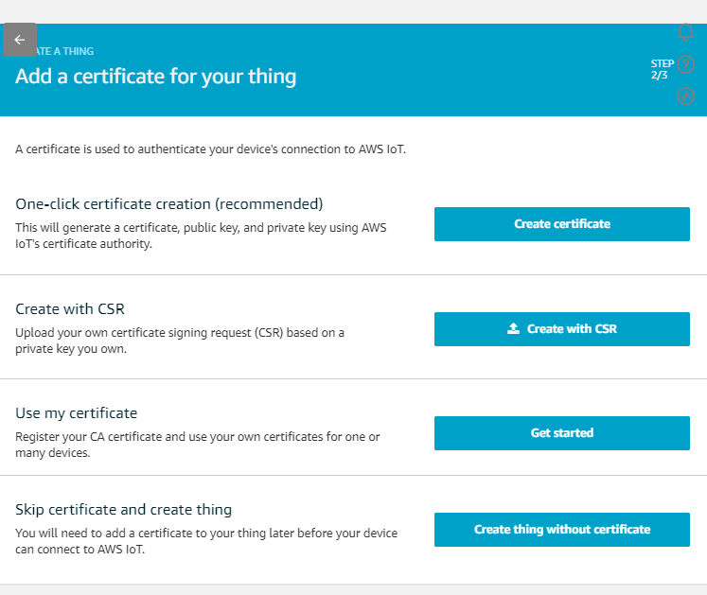
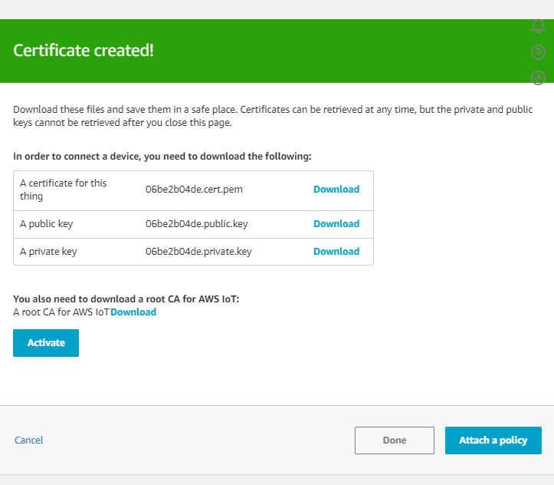
Register your Thing
3
Click the “One-click certification creation” button
4
The AWS IoT Platform will create 3 new certificates for your Thing, plus provide you the root CA for AWS IoT.
Public Key
Private Key
Thing Certificate Key
Root CA for AWS IoT
These keys should all be downloaded for future use when setting up your Thing
5
Click the “Activate” button
Notes:
This will take you to the page where we create the certificates used to secure and authenticate our Thing.

Slide 24
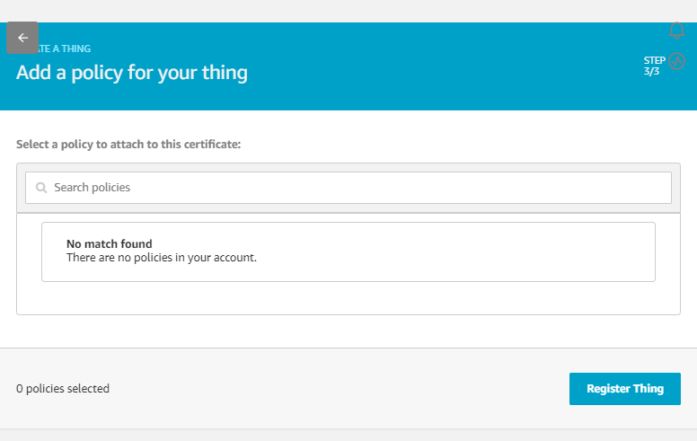
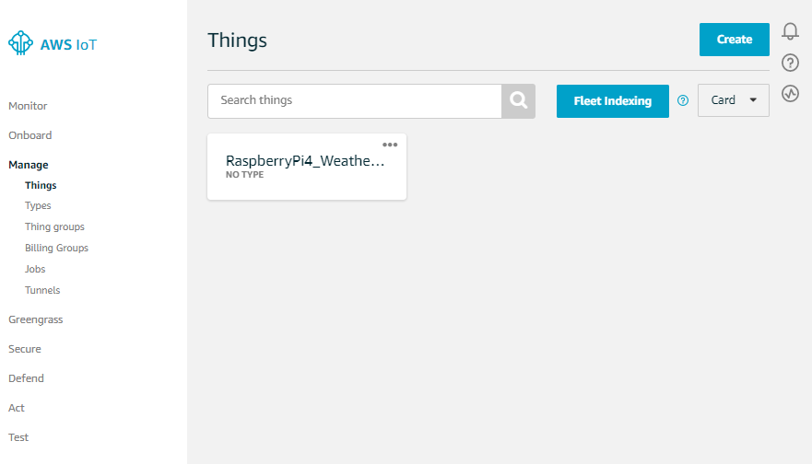
Register your Thing
6
Click the “Register thing” button
The security policy will be created and applied in future steps
7
Congratulations… you now have a Thing registered with the AWS IoT Platform.
Notes:
Note: We’ll create the initial security policy in the next section.

Slide 25
IOT GETTING STARTED
Register Your Thing
Register your device with the AWS IoT Core Framework to allow it to be managed by the platform.
Secure Your Thing
Secure your device by generating the required certificates and policies to allow secure communication between your gateway and the platform. In addition, we will register our device with AWS Cognito for Unauthenticated Identities.
Develop and Deploy Your Thing
Develop the require code to support your functionality with the AWS SDK for IoT.
Test Your Thing
Utilize the built-in testing tools provided with the AWS IoT platform to ensure two-way communication with your device.
Notes:
Now that our Thing is registered, let’s secure it.

Slide 26
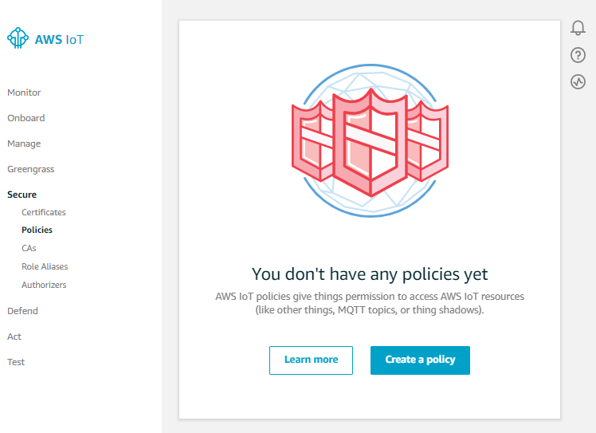
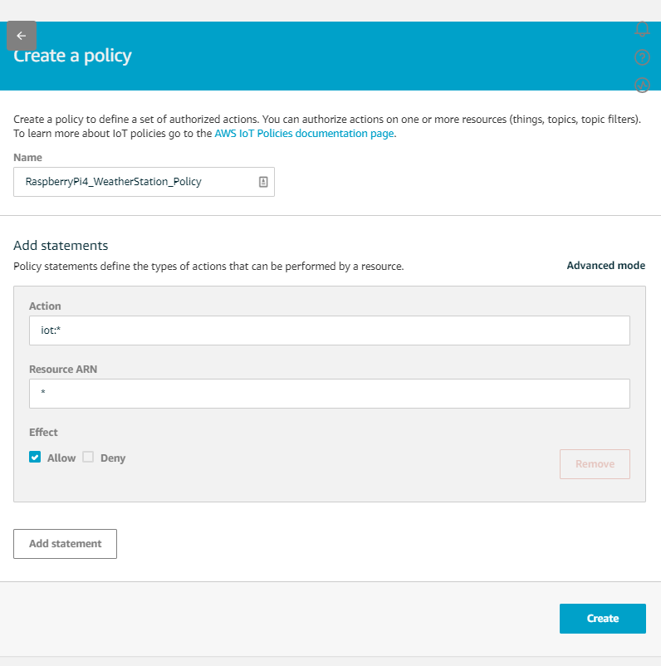
Secure your Thing
1
Using the IoT menu, select “Secure”, then “Policies”
2
Give the policy a name, domain for actions, a resource ARN and the type of effect for the policy
Name: RaspberryPi4_WeatherStation_Policy
Action: iot:*
Resource ARN: *
Effect: Allow checked
Click “Create”
Note: I purposely used the * in our action and ARN to generate an issue in Device Defender, so my security colleagues can lower their hands now. Normally, you may want to be more restrictive.
Notes:
Note: The * defined for the action and ARN was on purpose.

Slide 27
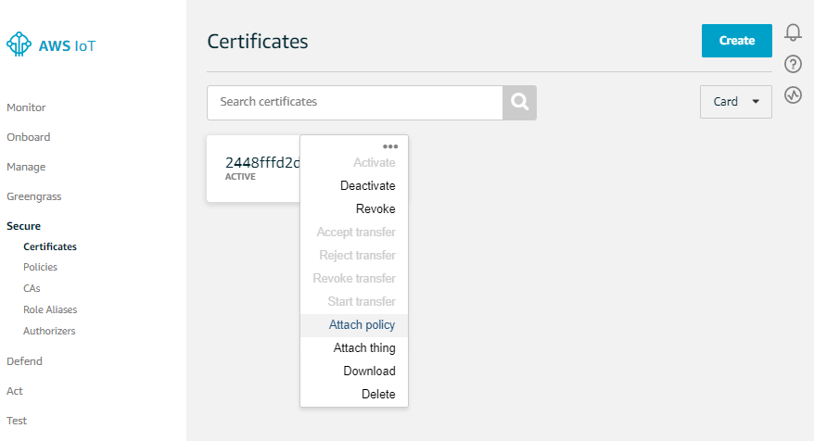
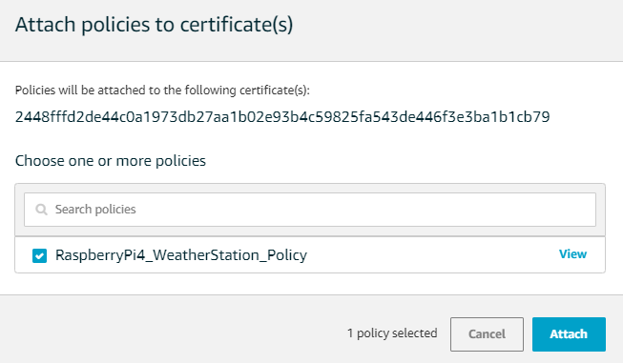
Secure your Thing
3
Using the IoT menu, select “Secure”, then “Certificates”
4
From your Certificates action menu, select “Attach Policy”
5
Check the Policy that was created and click the “Attach” button
Notes:
Next, we need to attach our newly created Policy to the certificate.

Slide 28
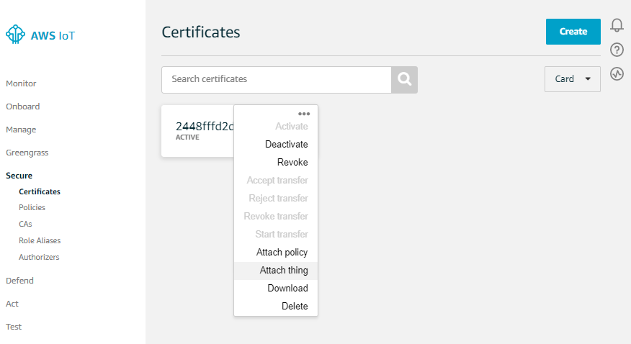
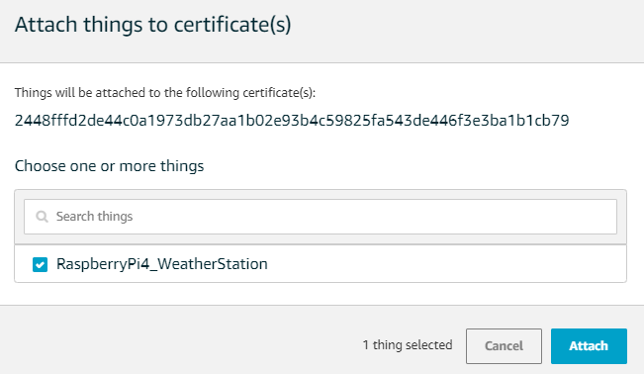
Secure your Thing
6
Using the IoT menu, select “Secure”, then “Certificates”
7
From your Certificates action menu, select “Attach thing”
8
Check the Thing that was created and click the “Attach” button
Notes:
Now, we want to bind our Thing to this certificate.

Slide 29
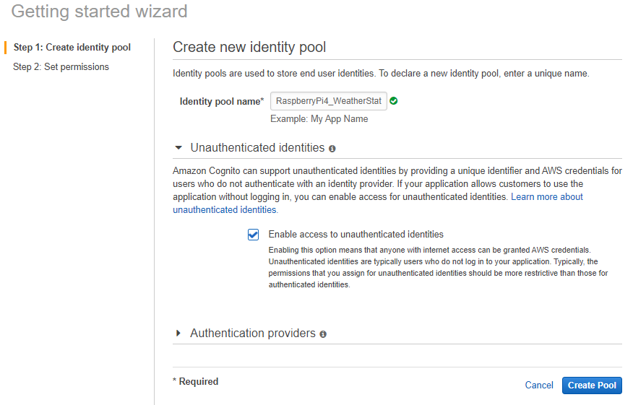
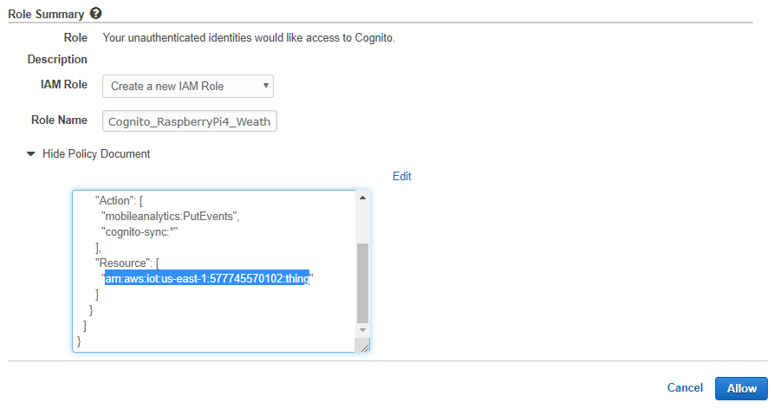
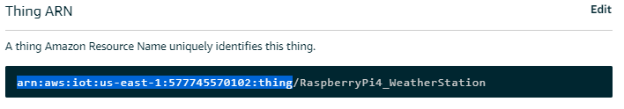
Secure your Thing
9
Using the AWS menu, search for and select “Cognito”
10
From the Cognito menu, select to “Manage Federated Identities”
11
Give the Identity Pool a Name and Check the box to enable unauthenticated identities, click then “Create”
Name: RaspberryPi4_WeatherStation_IdentityPool
12
Using the IoT menu, find the ARN of your Thing and enter it as the “Resource” for unauthenticated identities, then click “Allow”
Notes:
The bulk of the IoT security has been handled at this point, but we’ll rely upon Amazon Cognito to do the authentication. Since our Thing will not interactively login with a username and password, we setup a pool for unauthenticated identities. This will be bound to our Thing, which has the policy and certificate mapping.

Slide 30
IOT GETTING STARTED
Register Your Thing
Register your device with the AWS IoT Core Framework to allow it to be managed by the platform.
Secure Your Thing
Secure your device by generating the required certificates and policies to allow secure communication between your gateway and the platform. In addition, we will register our device with AWS Cognito for Unauthenticated Identities.
Develop and Deploy Your Thing
Develop the require code to support your functionality with the AWS SDK for IoT.
Test Your Thing
Utilize the built-in testing tools provided with the AWS IoT platform to ensure two-way communication with your device.
Notes:
That completes all the steps required to secure our Thing with the AWS IoT platform. Next, we’ll review the steps required to code the weather station functionality.

Slide 31
Develop and Deploy your Thing
1
Update your Raspberry Pi 4 to the latest firmware and patch levels
sudo rpi-update
sudo reboot now
sudo apt update
sudo apt full-upgrade
sudo apt clean
sudo reboot now
2
Setup our Project directory
sudo mkdir /var/project
sudo chgrp pi /var/project
sudo chmod 775 /var/project
Notes:
Notes:
rpi-update – Raspberry PI update to install latest firmware

Slide 32
Develop and Deploy your Thing
3
Install the Sense HAT Software Development Kit
sudo apt install sense-hat
sudo reboot
4
Install the AWS IoT Software Development Kit for Python
cd /var/project
git clone https://github.com/aws/aws-iot-device-sdk-python.git
cd aws-iot-device-sdk-python
sudo python setup.py install
Note: A version 2 of this Python SDK exists that is built upon the ACS (AWS Common Software).
5
Copy the 4 AWS Certificates that were generated to our projects/certs folder
Notes:
I didn’t use the version 2 of the SDK because the documentation seems to be lacking and there are a ton of resources online that give examples like my code.

Slide 33
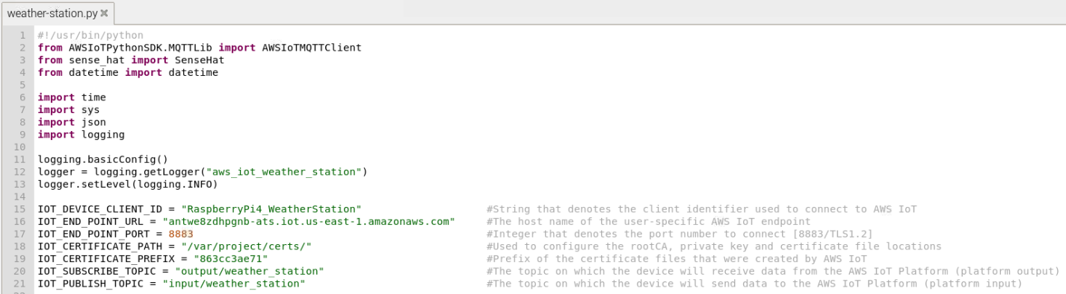
Develop and Deploy your Thing
6
Develop the Python code to Publish/Subscribe event data with AWS IoT
Establish our imports
Initialize our logging
Create Constants to manage our AWS IoT Configuration
Notes:
Notes:
We define our endpoint here
We also define our input and output topics… think of input as what is going TO the platform and Output is being sent FROM the platform.

Slide 34
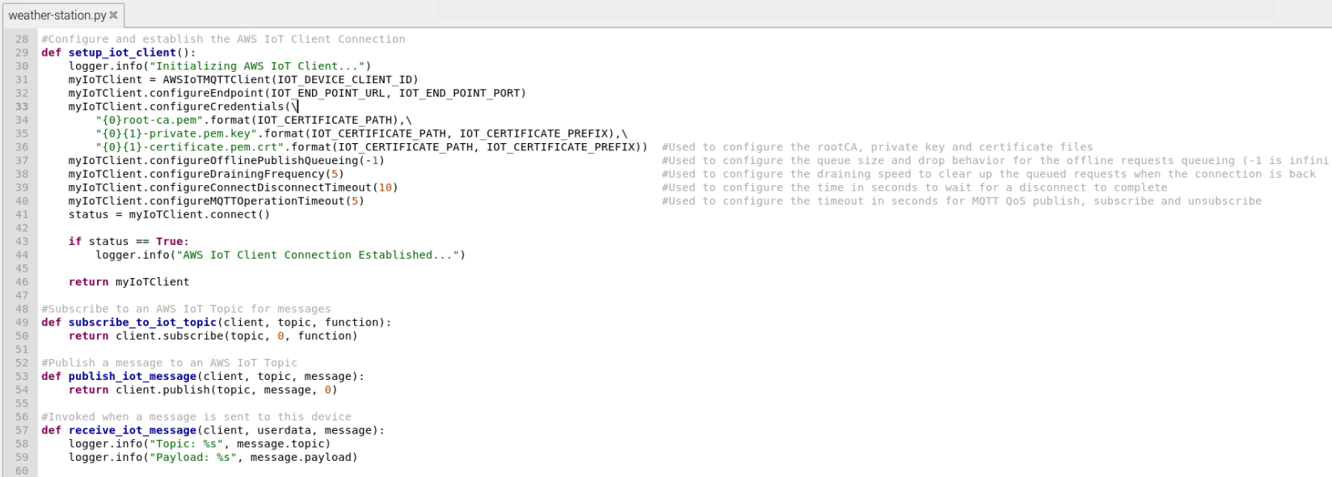
Develop and Deploy your Thing
6
Develop the Python code to Publish/Subscribe event data with AWS IoT (cont.)
Define a function to manage our AWS IoT Client connection
Define functions to manage our Publish and Subscribe functionality
Notes:
Notes:
There are some connection tuning parameters to set, I took the default values.

Slide 35
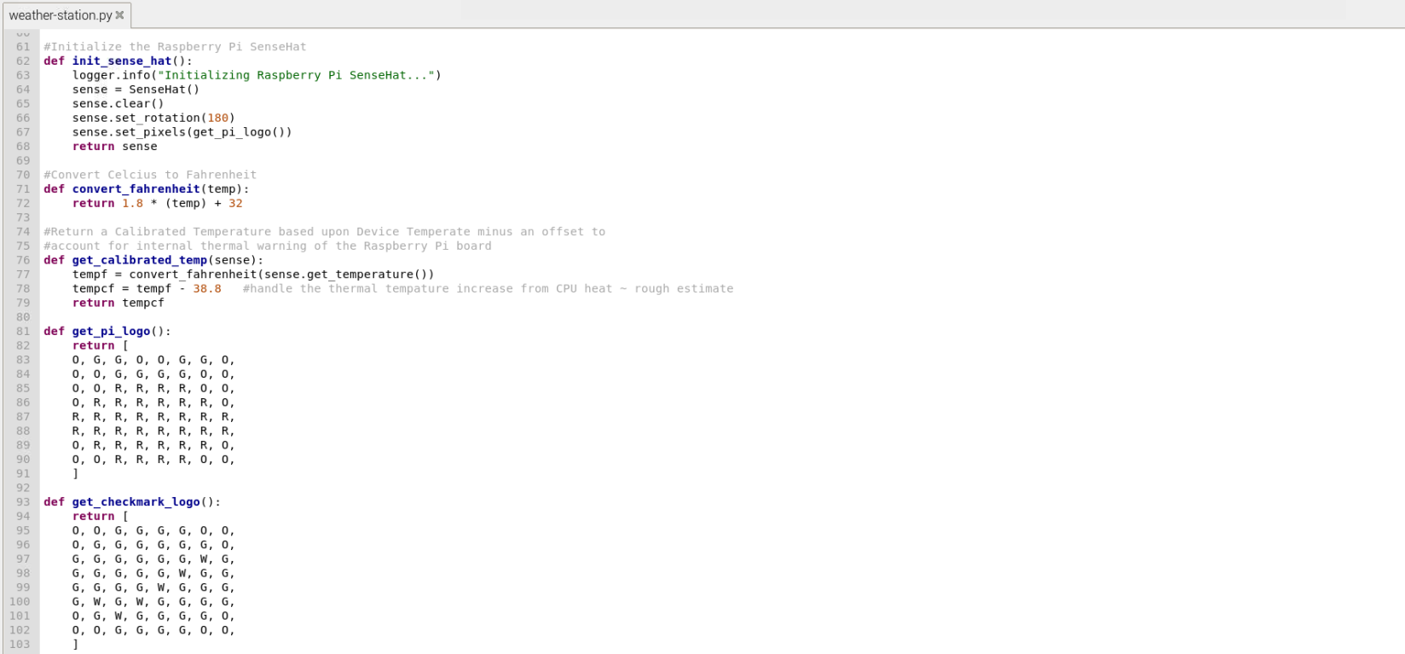
Develop and Deploy your Thing
6
Develop the Python code to Publish/Subscribe event data with AWS IoT (cont.)
Define a function to manage our Sense HAT client
Define helper functions capture and calibrate our sensor readings and define logos
Notes:
Notes:
The temperature is returned in Celsius, so I convert it to Fahrenheit. In addition, the Sense HAT is installed directly above the CPU of my Pi, thus creating some thermal heat that alters the temperature readout. I calibrated the temperature by subtracting an average value from it.
The Sense HAT has an 8x8 RGB pixel screen that you can toggle on and off. In the 2 logo functions, I designed a Raspberry and a Checkbox to display.

Slide 36
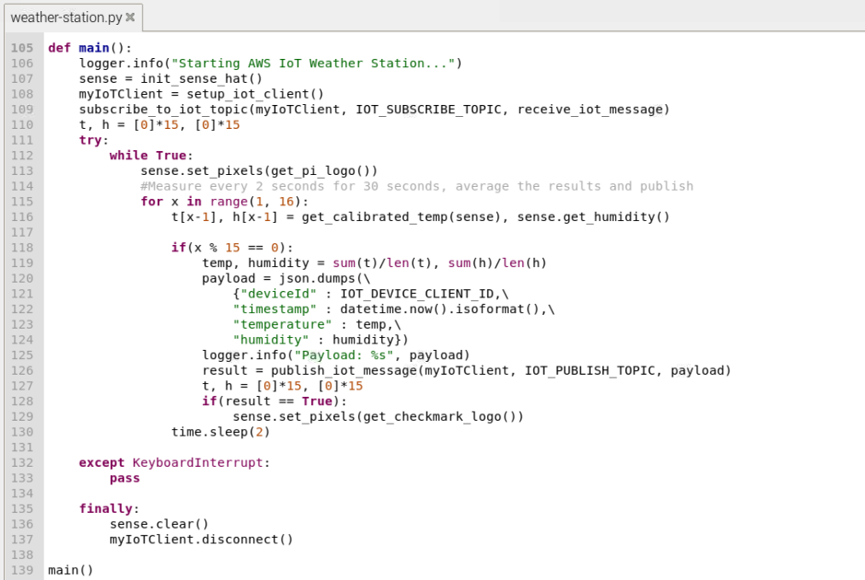
Develop and Deploy your Thing
6
Develop the Python code to Publish/Subscribe event data with AWS IoT (cont.)
Define the primary function that collects our sensor data and publishes it to AWS
Statistics are collected every 2 seconds and averaged over 30 second periods
JSON Payload
{
deviceId: “Device Name”,
timestamp: “ISO Timestamp”,
temperature: Float,
humidity: Float
}
Notes:
Notes:
The temperature readings are very sensitive and depending on the CPU heat can vary in between readings. So, to minimize the ups and downs, I take 15 readings over a 30 second interval and average the values before I send them to my IoT Platform.
The awesome part about this whole solution is from start to finish, I only wrote 139 lines of code… that’s it, which includes formatting and comments. The rest of the solution is all configuration based.

Slide 37
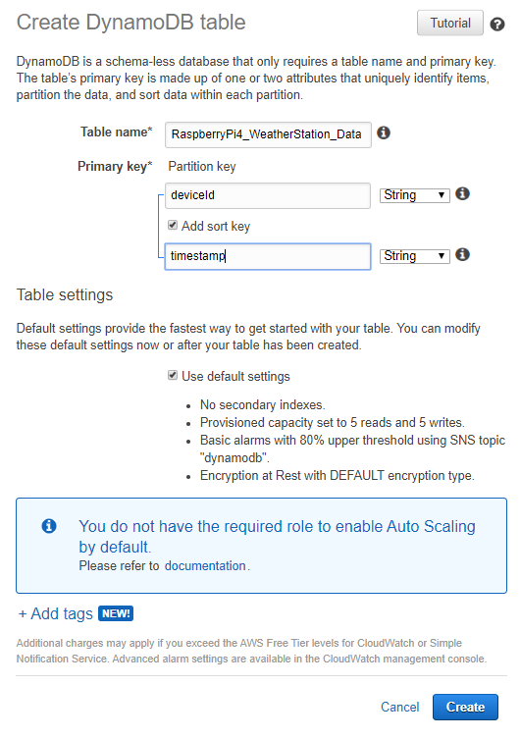
Develop and Deploy your Thing
7
Create a DynamoDB to store our Weather Station data
TableName: RaspberryPi4_WeatherStation_Data
Partition Key: deviceId
Sort Key: timestamp
Notes:
Notes:
We use the deviceId as our Partition key and the Timestamp as our sortkey

Slide 38
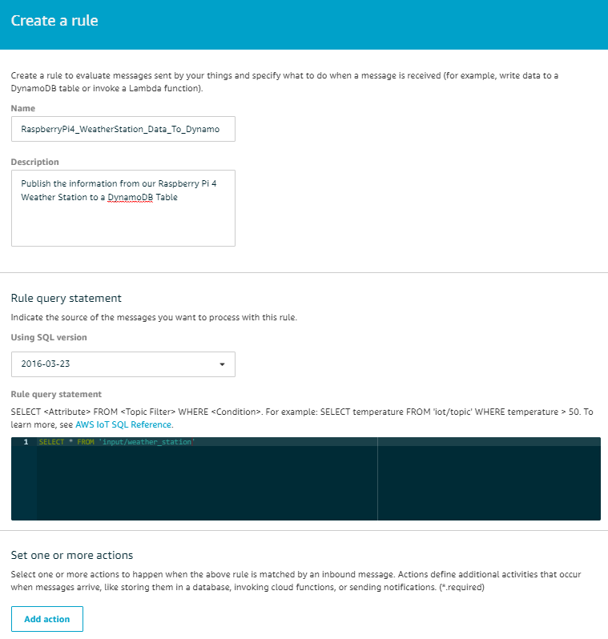
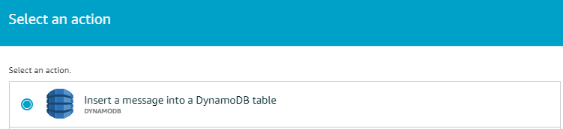
Develop and Deploy your Thing
8
Create an IoT Rule to persist data to DynamoDB by selecting “Act” from the IoT Menu and clicking “Create Rule” and completing the form
Name: RaspberryPi4_WeatherStation_Data_To_Dynamo
Description: Publish the information from our Raspberry Pi 4…
Rule Query Statement: SELECT * FROM ‘input/weather_station’
Note: ‘#’ can be used to collect from all Topics
9
Click the “Add action” button, select “Insert a message into a DynamoDB table, then click “Configure action”
Notes:
Now, we create a rule to act upon whenever we get a message from our IoT device.
Notes:
There are about 20 different actions that can be used when creating a business rule.

Slide 39
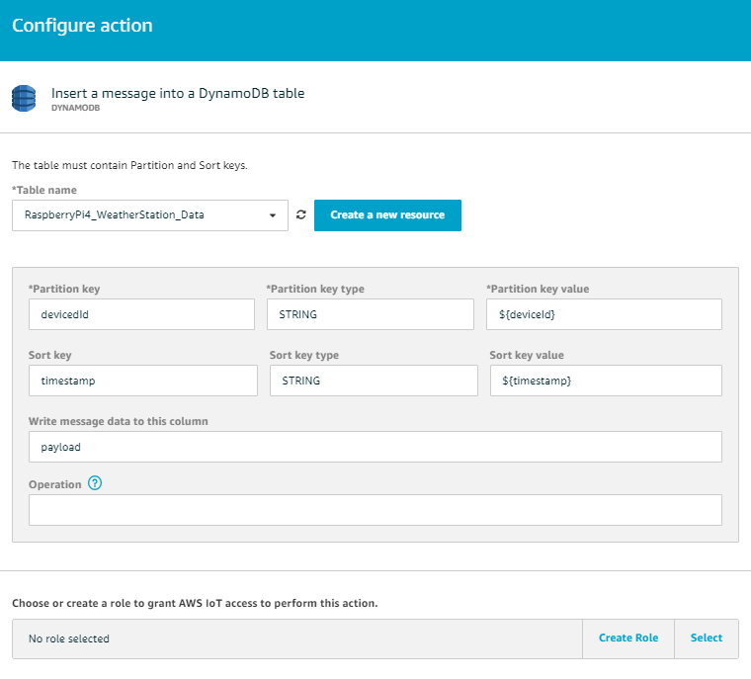
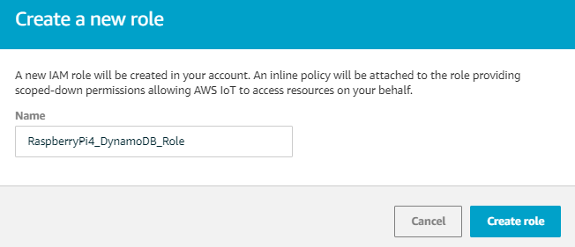
Develop and Deploy your Thing
10
Complete the form with the following information”
TableName: RaspberryPi4_WeatherStation_Data
Partition key value: ${deviceId}
Sort key value: ${timestamp}
Write message data to this column: payload
11
Click the “Create Role” Button
Name: RaspberryPi4_DynamoDB_Role
Click “Create role” button, then Click the “Add action”, then Click the “Create rule” button
Notes:
Finally, we need to map the data from our JSON payload into the DynamoDB table.
Notes:
We create a role to allow the IoT Platform to access DyanmoDB
That’s it!

Slide 40
IOT GETTING STARTED
Register Your Thing
Register your device with the AWS IoT Core Framework to allow it to be managed by the platform.
Secure Your Thing
Secure your device by generating the required certificates and policies to allow secure communication between your gateway and the platform. In addition, we will register our device with AWS Cognito for Unauthenticated Identities.
Develop and Deploy Your Thing
Develop the require code to support your functionality with the AWS SDK for IoT.
Test Your Thing
Utilize the built-in testing tools provided with the AWS IoT platform to ensure two-way communication with your device.
Notes:
Now that we have all the code deployed, we need to figure out how to test the device.

Slide 41
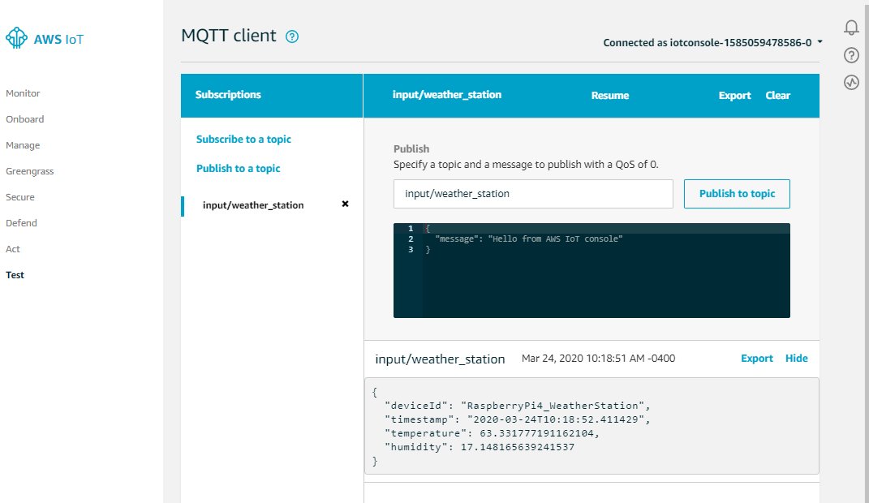
TEST your Thing
1
Using the IoT menu, select “Test”, then “Subscribe to a topic”
2
Enter the name of your input Topic to subscribe to
Topic Name: input/weather_station
3
Confirm the JSON messages as they appear
Notes:
The AWS IoT Core gives you some basic testing functionality to validate you are sending and receiving messages from your device. First, we’ll test that we are getting messages from our device. We should expect to see our payload coming into the Core service about every 30 seconds.

Slide 42
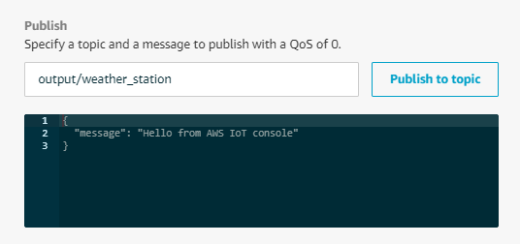
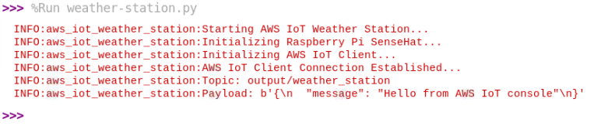
TEST your Thing
4
Using the IoT menu, select “Test”, then “Publish to a topic”
5
Enter the name of your output Topic to subscribe to
Topic Name: output/weather_station
6
Confirm the JSON messages as they appear in your Python Console
Notes:
Now that we know we are getting messages, let’s confirm we can send our device a message. In our case, I just log the incoming message. However, we could do many other things if desired.

Slide 43
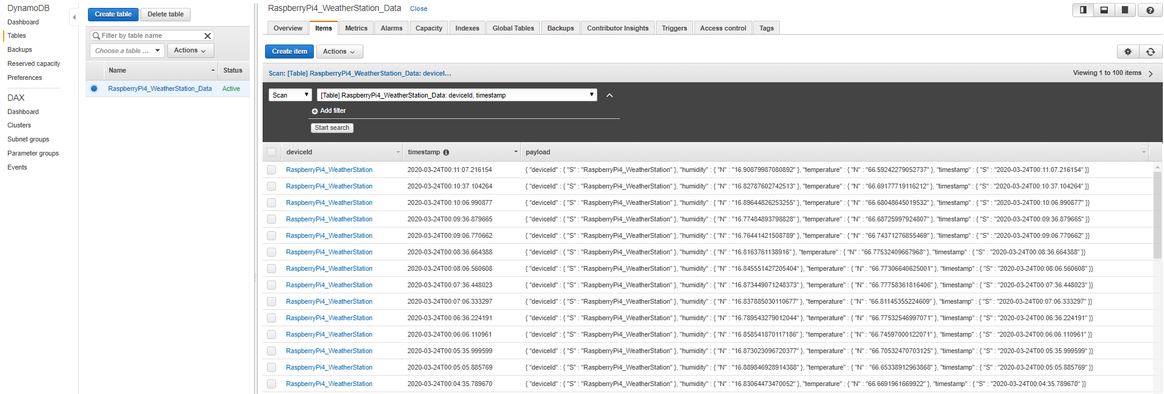
TEST your Thing
7
Validate that you see the Weather Data being written to DynamoDB, by viewing the items in the table created
Notes:
Let’s confirm our business rule that is writing data to our DynamoDB in the format we expect. So, we switch over to the DynamoDB table and inspect the items.

Slide 44
IOT GETTING STARTED
Register Your Thing
Register your device with the AWS IoT Core Framework to allow it to be managed by the platform.
Secure Your Thing
Secure your device by generating the required certificates and policies to allow secure communication between your gateway and the platform. In addition, we will register our device with AWS Cognito for Unauthenticated Identities.
Develop and Deploy Your Thing
Develop the require code to support your functionality with the AWS SDK for IoT.
Test Your Thing
Utilize the built-in testing tools provided with the AWS IoT platform to ensure two-way communication with your device.
Notes:
That outlined all the steps that you need to take to setup your IoT platform from scratch. At this point, we have a fully functional weather station logging data to our AWS platform.

Slide 45

AWS IOT WEATHER STATION DEMO
Review the AWS IoT Configuration
See the Weather Station “In Action”
Review an IoT Device audit with Device Defender
Resolve an issue identified by Device Defender
DEMO TIME
Notes:
Now, let’s get out of the PowerPoint and into the AWS console to see this in action. The provisioning time to launch this from scratch doesn’t fit well within out time constraints today, so we’ll review all the configuration that we just walked through to give you an idea of layout.
We’ll also dive into Device Defender and look at some of the audits that have scanned my device and show how easy it is to resolve the issues based upon Amazon’s recommendation.
Switch to AWS Console…

Slide 46
AWS COST MODEL
The AWS pricing model is built for scale, we could add another 10 devices at virtually the same cost (~$0.26 per device average)
AWS Service | Usage | Estimated Monthly Cost
AWS IoT Core – Connectivity | 90k calls @ 20ms/call ~ 30 minutes used | <$0.01
AWS IoT Core – Messages | Priced per million messages ~ 90k used | $1.00
AWS IoT Core – Rules Engine | Priced per million triggers/actions ~ 90k used | $0.30
AWS Device Management – Registration | Priced per 1,000 devices ~ 1 device used | $0.10
AWS Device Defender – Audit | Priced per 100,000 devices ~ 1 device used | <$0.01
Amazon Cognito | Free for under 50,000 identities | $0.00
Amazon Dynamo DB | Priced per million read/write ops ~ 90k used | $1.25
TOTAL MONTHLY COST |  | $2.67
Notes:
Everything sounds great until you know the cost, and, in this case, it sounds even better. I put together a quick cost model and although I may not be 100% correct, it does get close to what this solution will cost. Since most of the pricing is built for scale, I’m not fully taking advantage of the model with just 1 device. I could add about 10 more devices for roughly the same cost and average about 26 cents per device. So, this cost model can scale for thousands of devices without breaking the bank too bad.

Slide 47
TECHNOLOGY LINKS
Hardware Components
CanaKit Raspberry Pi 4 4GB Starter MAX Kit - 64GB Edition
https://www.amazon.com/CanaKit-Raspberry-4GB-Starter-MAX/dp/B07XPHWPRB/ref=sr_1_3
Raspberry Pi RASPBERRYPI-SENSEHAT Sense HAT
https://www.amazon.com/RASPBERRY-PI-RASPBERRYPI-SENSEHAT-Raspberry-Orientation-Temperature/dp/B014HDG74S/ref=sr_1_3
Hologram Nova Global Cellular Modem
https://hologram.io/store/nova-global-cellular-modem/55
Technology
AWS IoT Platform
https://aws.amazon.com/iot/
AWS IoT Python SDK Documentation
https://s3.amazonaws.com/aws-iot-device-sdk-python-docs/html/index.html
Source Code
AWS IoT Weather Station Python Source Code
https://github.com/orgs/cleanslate-technology-group/aws-iot-weather-station
Raspberry Pi Platform
https://www.raspberrypi.org/
Sense HAT Python SDK
https://pythonhosted.org/sense-hat/
Notes:
If you are curious about any of the hardware components, I have provided the links to Amazon to purchase them for yourself. I also included some additional links that may be of interest from a technology standpoint.
If you care to pick my Python code apart or use it as a reference, I also included our Public GitHub repository.

Slide 48



Educational LINKS
PluralSight
AWS IoT: The Big Picture
https://www.pluralsight.com/courses/aws-iot-big-picture
Managing Connected Devices with AWS IoT Device Management
https://www.pluralsight.com/courses/aws-iot-device-management
Analyzing Your Data with AWS IoT Analytics
https://www.pluralsight.com/courses/aws-iot-analytics
Linux Academy
Configuring Your First IoT Device Lab
https://linuxacademy.com/hands-on-lab/101e6431-b174-464d-b130-527914d768d3/
A Cloud Guru
How to Turn on a Lamp from Anywhere in the World using AWS IoT Greengrass
https://acloud.guru/series/acg-projects/view/112
Notes:
If you are ready to jump in and learn more about IoT, there are a lot of resources available online. However, I included a couple of courses and labs from the more popular training sites. AWS also has lots of great material as well.
The A Cloud Guru project is very similar to what we have done today, except it uses the Greengrass product if you wanted to compare the differences.

Slide 49
LET’s CONNECT
CleanSlate Technology Group is an AWS Advanced Partner specializing in Application Modernization using Cloud-based technologies.
Contact us to help you on your IoT Journey!
Be Creative – think of the next must-have IoT concept and build it yourself!
Get Ready – use the educational links in this presentation and grow your skills
Start Simple – implement a simple PoC, like a Weather Station or Health Device
Leverage a Platform – AWS IoT is a great platform to learn and use
Check Out My Project - https://github.com/orgs/cleanslate-technology-group/aws-iot-weather-station
Darren Mills darren.mills@cleanslatetg.com
THANK YOU
Chris Konow chris.konow@cleanslatetg.com
Notes:
My challenge to you is to create your own IoT device, all you need is that million-dollar idea to make you rich! It’s relatively cheap to get started with, something you can easily do for under a $100 and a great way to get kids started in technology. Start with something simple to implement to get your feet wet and use the AWS IoT platform to make your life easier.
Once we wrap up here, I’ll be available to answer questions in the #hardware-iot channel

Slide 50
our offer to You
As a THANK YOU for attending one of our speaking sessions, connect with us on our Slack Channel for one of the offers below.
#sponsor-cleanslate
Cloud Optimization Assessment with CloudCheckr - This evaluation will provide key recommendations for cloud cost optimization that will result in immediate savings opportunities – up to 30% cost savings
Cloud Strategic Planning Workshop – This workshop will introduce our proven Cloud Strategic Planning Framework and highlight the steps necessary to achieve successful cloud adoption including implementation of Cloud Architecture, Security, and Dev/Ops
Notes:
I would like to thank you for attending this session. As a thank you, CleanSlate would like to make aware of some special offers for all attendees that we have found provide great value.
The first is offering is focused on Cloud Cost Optimization – everyone wants to save money!
The second is our planning workshop which is designed to help you build a strategy to get the most out of your cloud investment
If you're interested, please head over to the CleanSlate Slack Channel and someone will connect with you.
Thanks again for your time today and hope you enjoy the rest of your conference!

